Slide 1
Unit4
Hard Disk Interfaces

Slide 2
What is hard disk interface??
The hard disk interface is the connecting part between the hard disk and the host computer system, and its function is to transmit data between the hard disk cache and the host memory.
Different hard disk interfaces determine the data transmission speed between the hard disk and the computer.
In the entire system, the quality of the hard disk interface directly affects the speed of the program and the performance of the system.

Slide 3
hard disk interfaces are divided into five types:
parallel ATA (PATA, also called IDE or EIDE)
(ATA Advanced Technology Attachment)
SATA
SCSI

Slide 4
IDE is mostly used in household products.
And some of it are used in website servers.
SCSI is mainly used in the server market.
While Fibre Channel is only used in high-end servers and is expensive.
SATA is now the mainstream hard disk.

Slide 5
Most notebook computers and desktop computers use it, and solid state hard drives also use it.
SAS is generally used in servers.
It has fast transmission speed and strong reliability.
Under the broad categories of IDE and SCSI, there has a variety of specific interface types that can be divided according to different technical specification and transmission speed.

Slide 6
IDE
The full name of IDE is "Integrated Drive Electronics", and its original meaning refers to the hard disk drive that integrates the "hard disk controller" and the "disk body".
This approach reduces the number and length of cables for the hard disk interface, enhances the reliability of data transmission, and makes hard disk manufacturing easier.
Many hard disks used to have IDE interfaces, but now almost all hard disk interfaces are standard with SATA.

Slide 7
IDE represents a type of hard disk interfaces
This type of interface has been eliminated with the development of technology.
With the time passes, more types of hard disk interfaces are developed, such as ATA, Ultra ATA, DMA, Ultra DMA and other interfaces are all IDE hard disk interfaces.

Slide 8
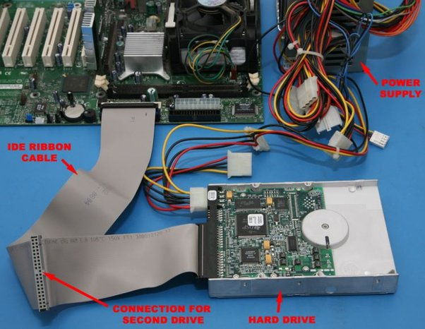

Slide 9
IDE Advantages and Disadvantages
Advantages: Compatible and cost-effective.
Disadvantages: slow data transmission speed, short cable length, fewer connected devices, no support for hot swap, poor upgrading ability of interface speed.

Slide 10
Hot-swappable describes a component device that can be removed or installed without powering down the host computer.
For example, eSATA, FireWire, and USB are examples of interfaces that are hot-swappable on computers

Slide 11
What is SCSI?
The full name of SCSI is "Small Computer System Interface", which is a completely different interface from IDE.
SCSI is not specifically designed for hard disks, but a high-speed data transmission technology widely used in minicomputers.

Slide 12
It has the advantages of wide application range, multitask, large bandwidth, low CPU occupancy rate, and hot swap.
So SCSI is mainly used in medium and high-end servers and high-end workstations.
But the higher price makes it difficult to popularize like IDE.
SCSI also has some potential problems.
It has limited system BIOS support, and it has to be set for each computer.
There's also no common SCSI software interface.

Slide 13
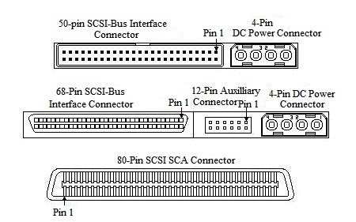

Slide 14
It's a fast bus that can connect lots of devices to a computer at the same time, including hard drives, scanners, CD-ROM/RW drives, printers and tape drives.

Slide 15
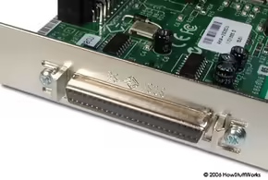
SCSI Connector

Slide 16
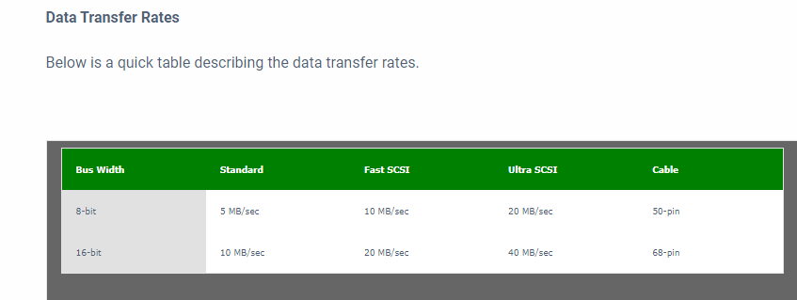

Slide 17
What is SATA?
SATA stands for "Serial Advanced Technology Attachment" or "Serial ATA". It is an interface used to connect ATA hard drives to a computer's motherboard.
SATA adopts serial connection mode.
Serial ATA bus uses embedded clock signal, which has stronger error correction ability. Compared with the past, its biggest difference is that it can check transmission instructions (not just data).

Slide 18
Errors are automatically corrected, which greatly improves the reliability of data transmission.
Now the general interface is SATA interfaces.
The reason why it can replace IDE is because the performance of the SATA is much better than that of the IDE.
SATA speed is also much higher than IDE, and it also supports hot swap/hot-plugging.

Slide 19
SATA Interface
Most of the computers we use are also SATA interfaces.
The current SATA interface has three versions 1.0, 2.0, and 3.0.
The larger the version number, the later it appears, the better the performance, which mainly due to the faster data transfer rate.
SATA 3.0 is the most common interface used today, though there have been four revisions since its introduction, namely 3.1 through 3.4.

Slide 20
The SATA interface version is backward compatible, and the higher version is compatible with the lower.

Slide 21
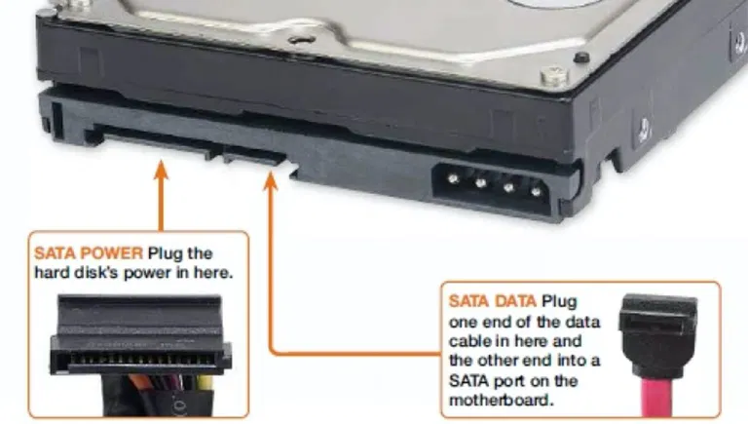

Slide 22
IDE vs SATA Interface
SATA hard disk has a new design structure, fast data transmission, save space, and many other advantages over IDE hard disk:
1) SATA hard disk has a higher transmission speed than IDE hard disk.
SATA can provide a peak transfer rate of 150MB/s. It will reach 300 MB/s and 600 MB/s with the development.
At that time, we will get a transfer rate nearly 10 times faster than IDE hard drives.

Slide 23
2) Compared with the data cable of IDE hard disks, the SATA cable is small and thin.
And the transmission distance is long, which can be extended to 1 meter, making it easier to install equipment and wiring in the machine.
Because the size of the connector is small, this kind of cable effectively improves the air flow inside the computer and also speeds the heat dissipation in the case.

Slide 24
The power consumption has been reduced.
SATA hard drives can work with 500 mA of current.

Slide 25
following two are the main types of SATA cables:
SATA Data Cables: These cables typically have seven pins for transferring data.
These connect the drives to the motherboard of the computer systems.
One end of the SATA cable plugs into the back of the hard drive of the computer system and the other end plugs into the computer's motherboard.

Slide 26
SATA Power Cables: These cables typically have fifteenth pins. These connect to the power supply.

